Slide 1

E-Invoice Software

Slide 2
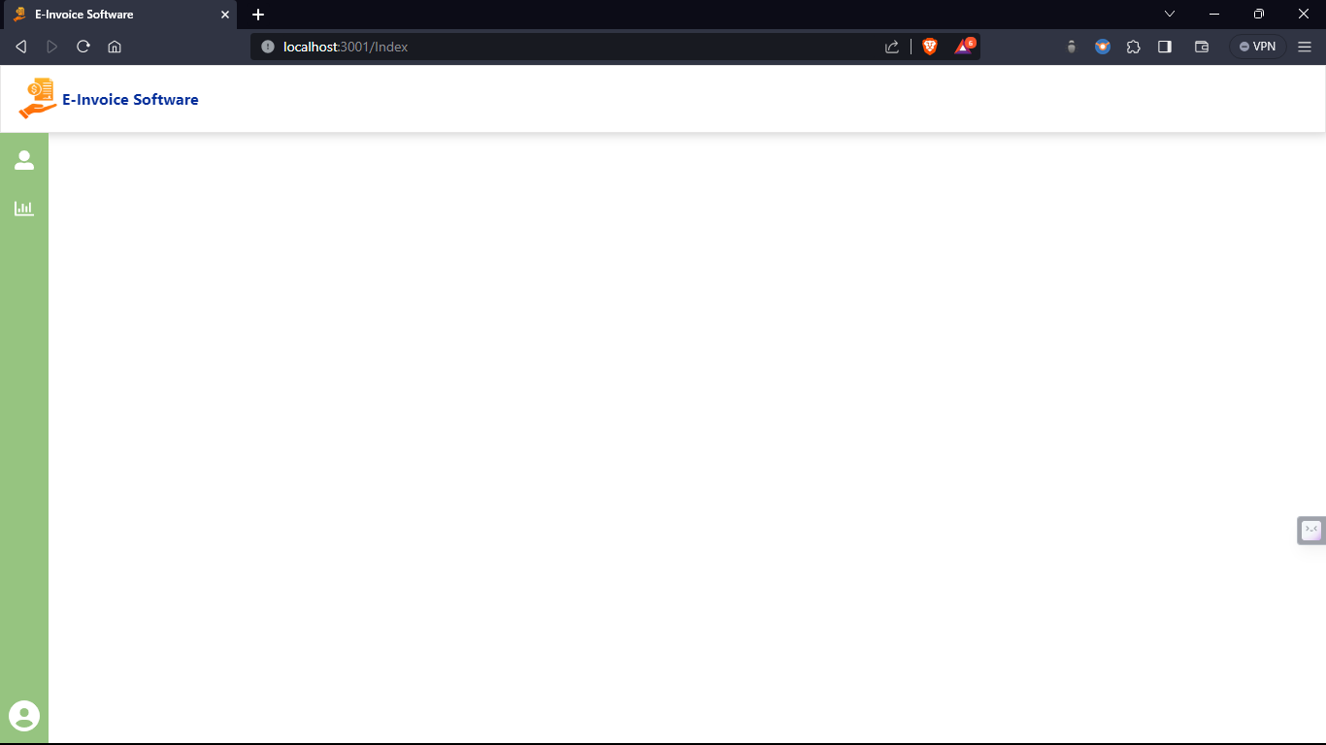
E-Invoice Software

Slide 3
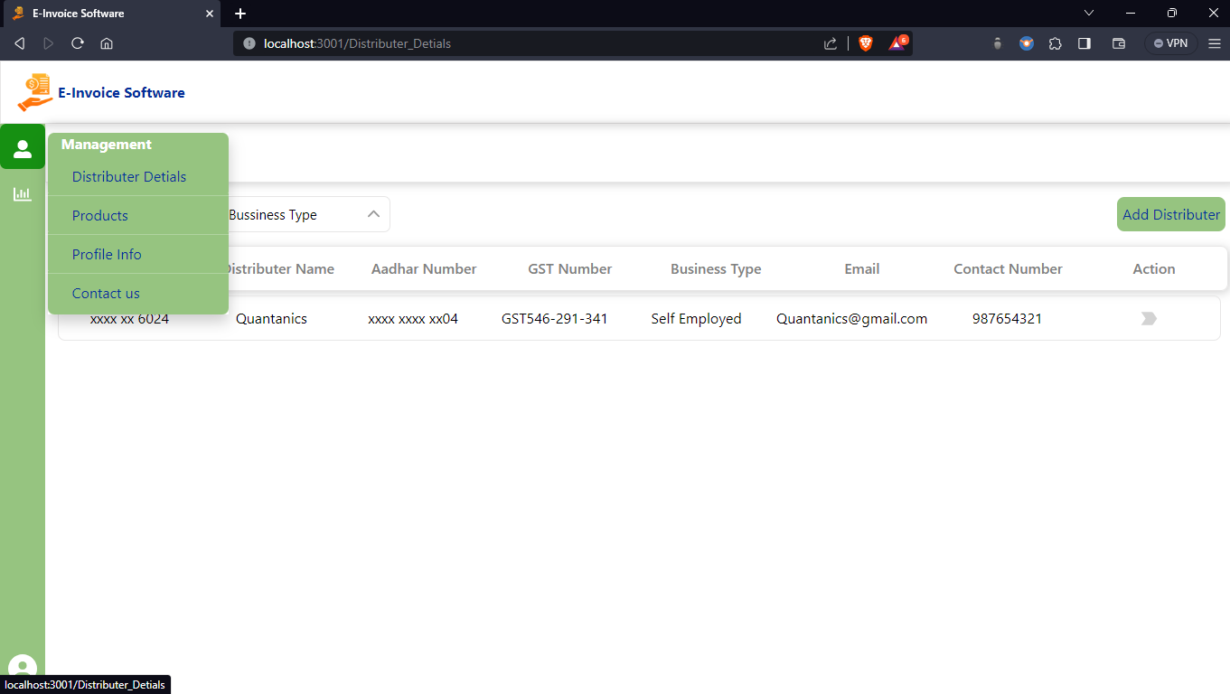
E-Invoice Software

Slide 4
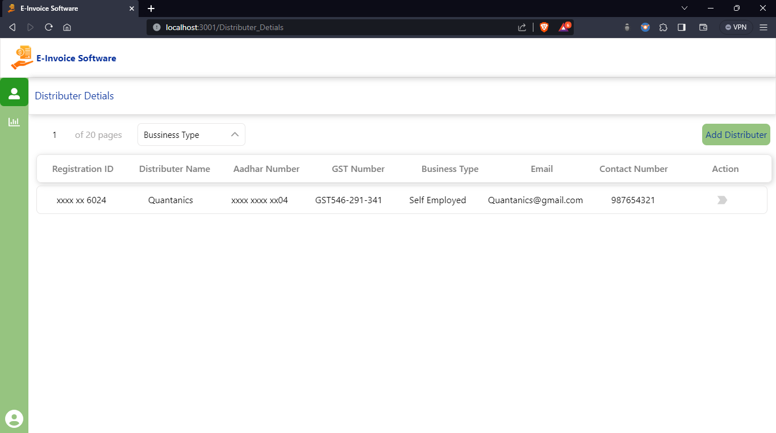
E-Invoice Software

Slide 5
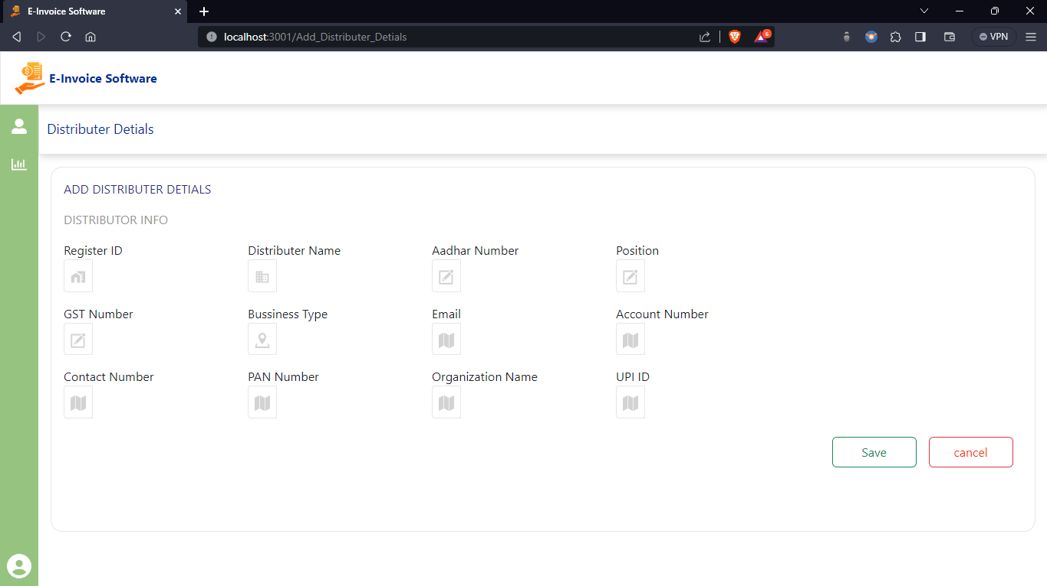
E-Invoice Software

Slide 6
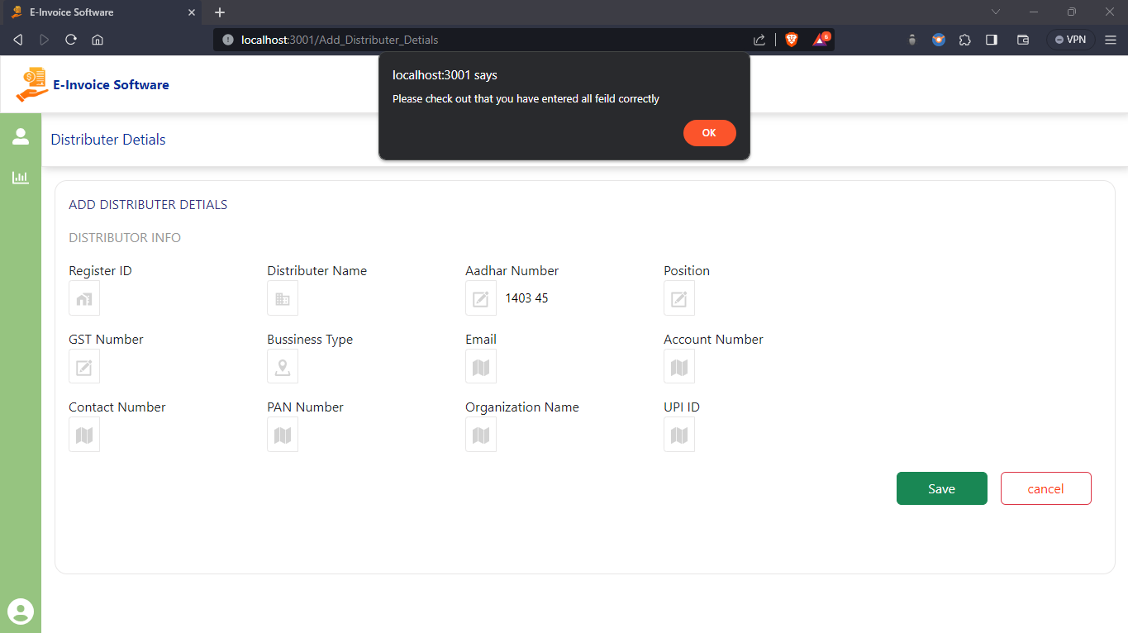
E-Invoice Software

Slide 7
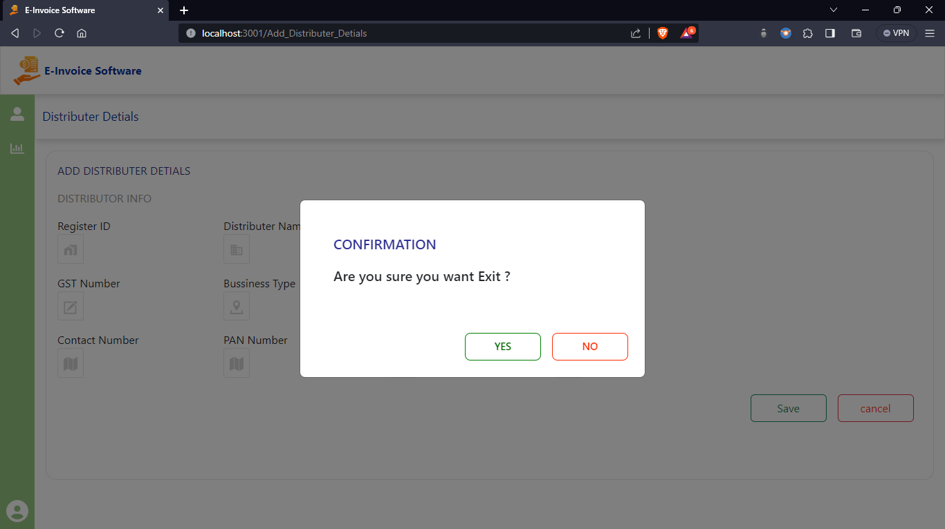
E-Invoice Software

Slide 8
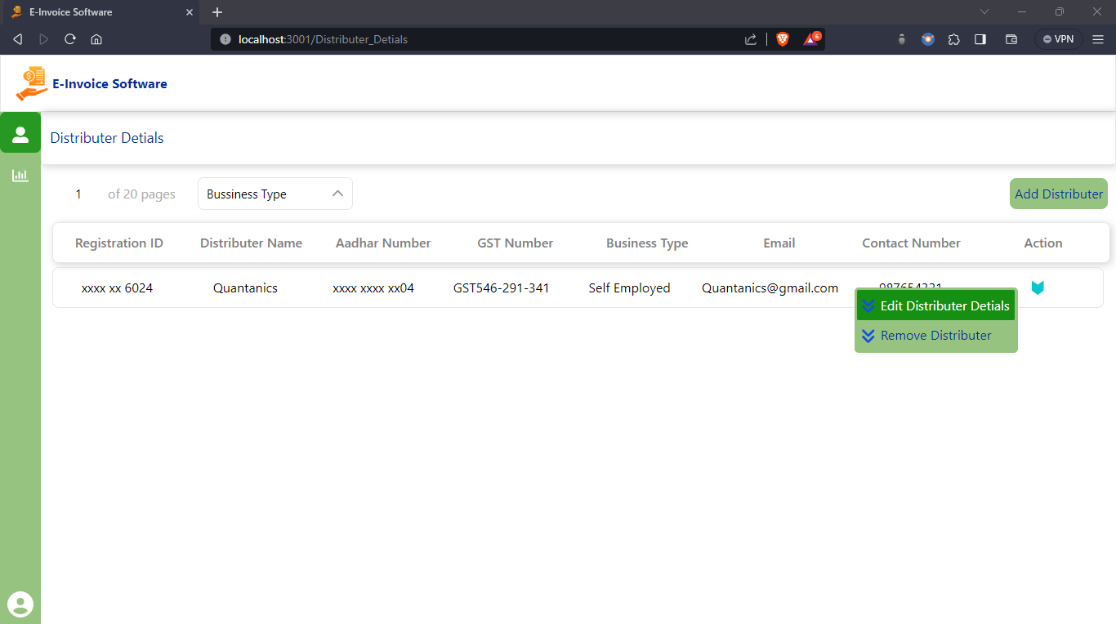
E-Invoice Software

Slide 9
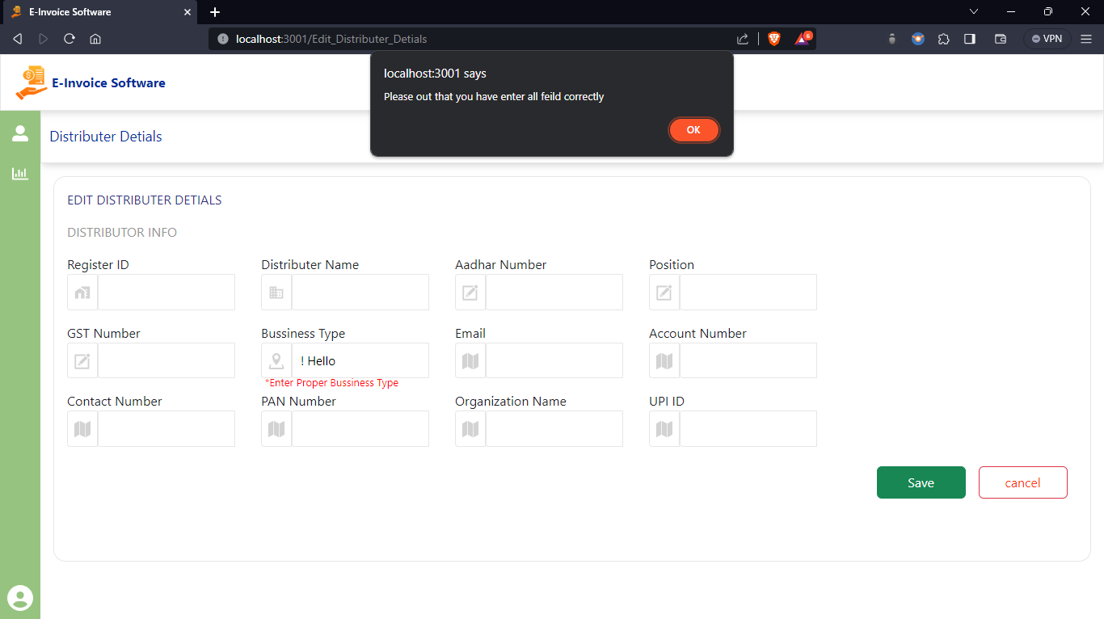
E-Invoice Software

Slide 10

E-Invoice Software

Slide 11
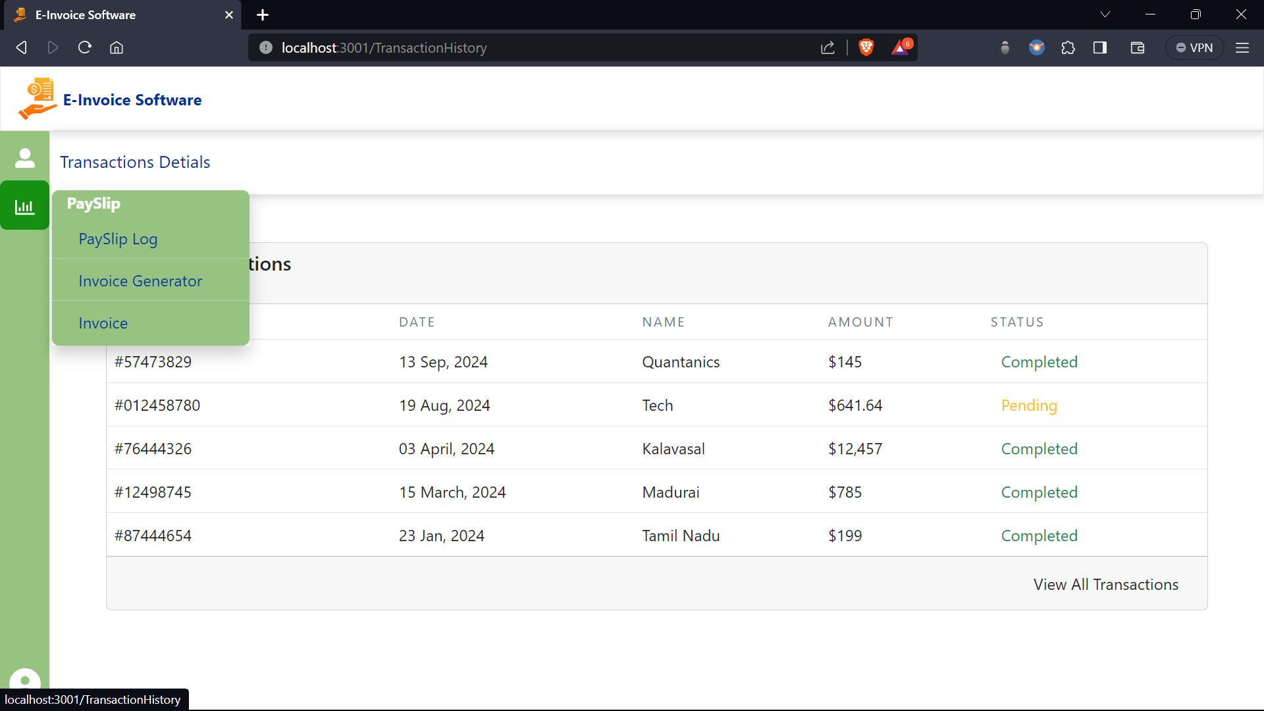
E-Invoice Software

Slide 12
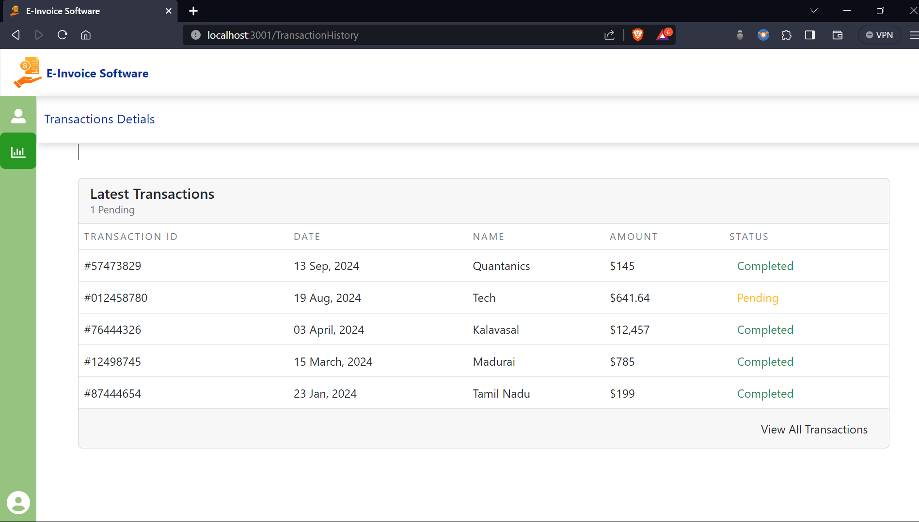
E-Invoice Software

Slide 13
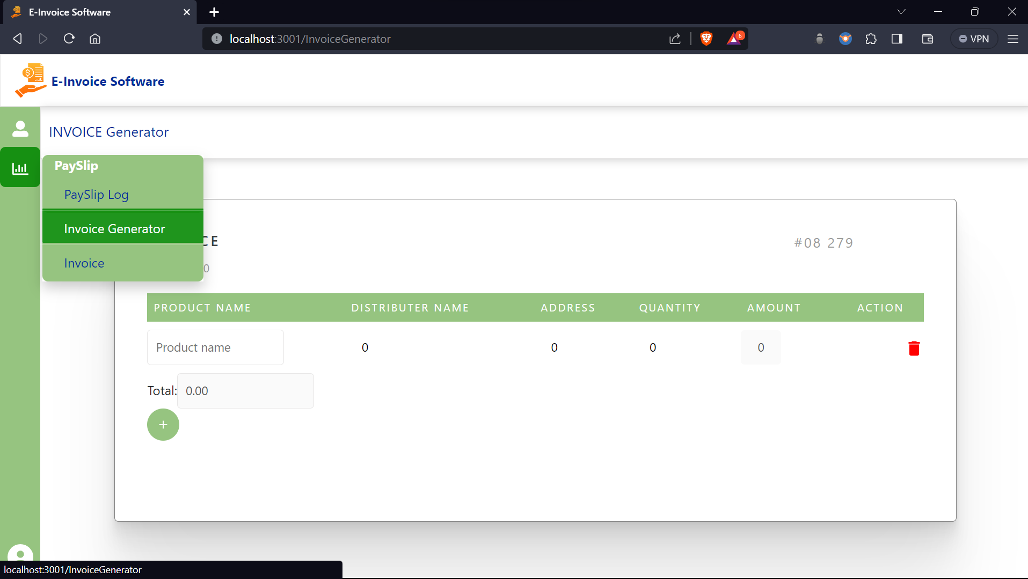
E-Invoice Software

Slide 14
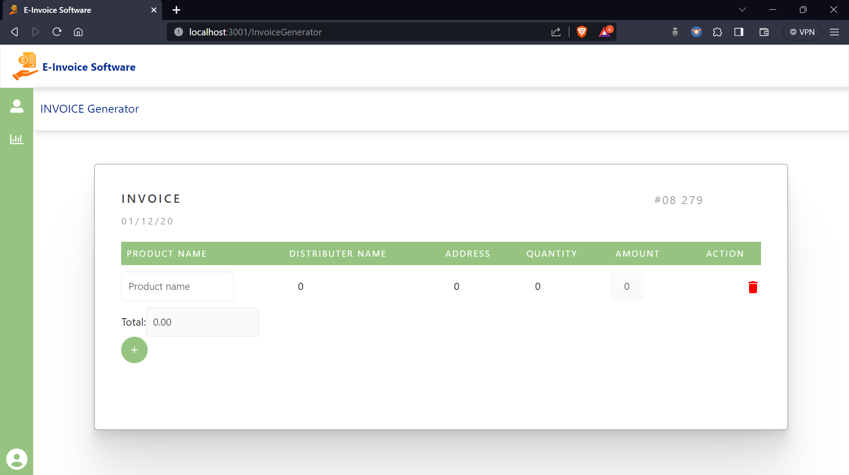
E-Invoice Software

Slide 15
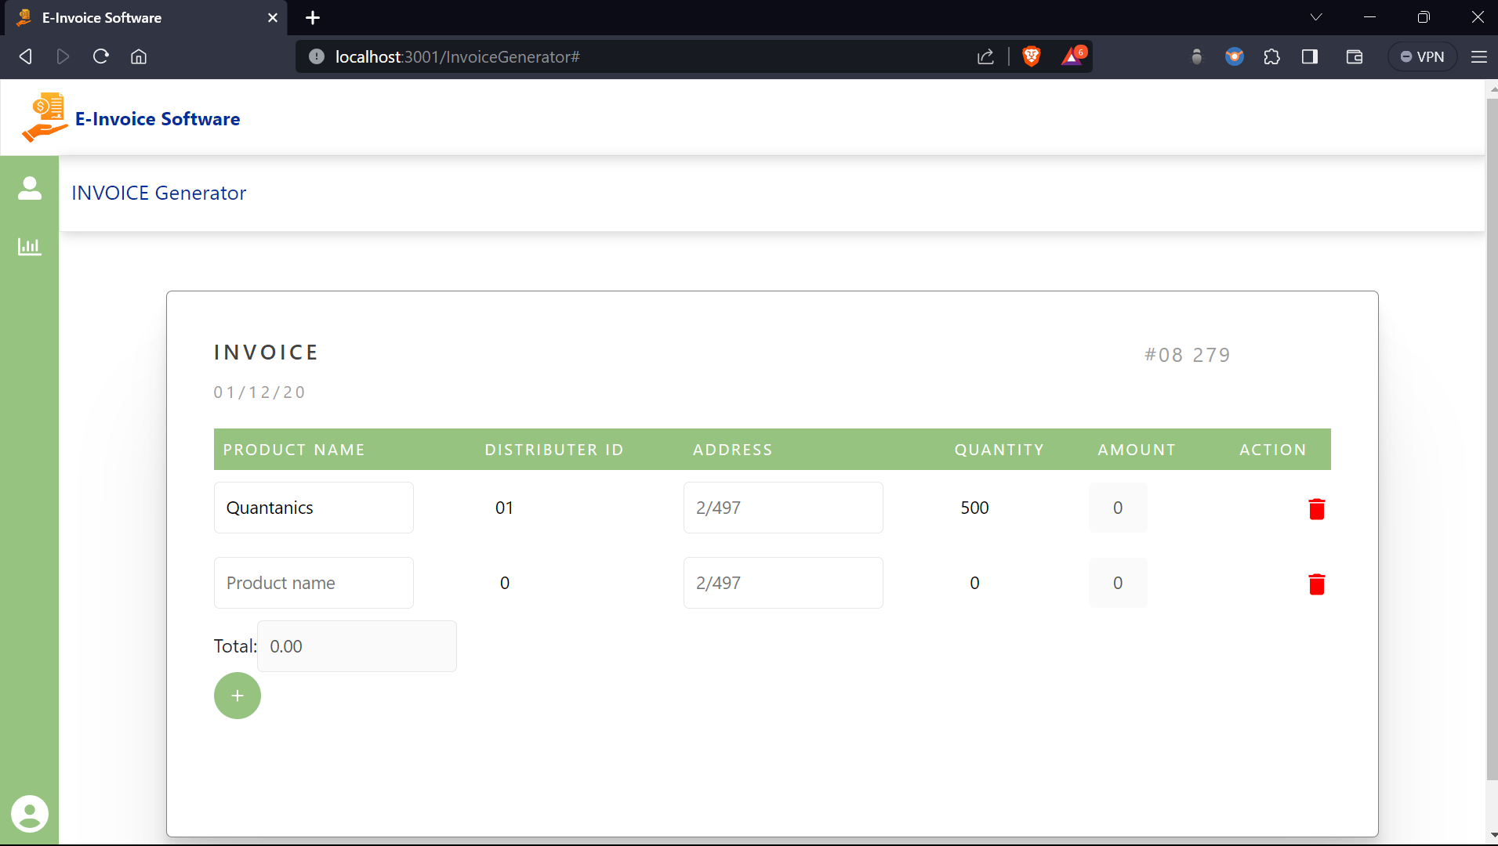
E-Invoice Software

Slide 16
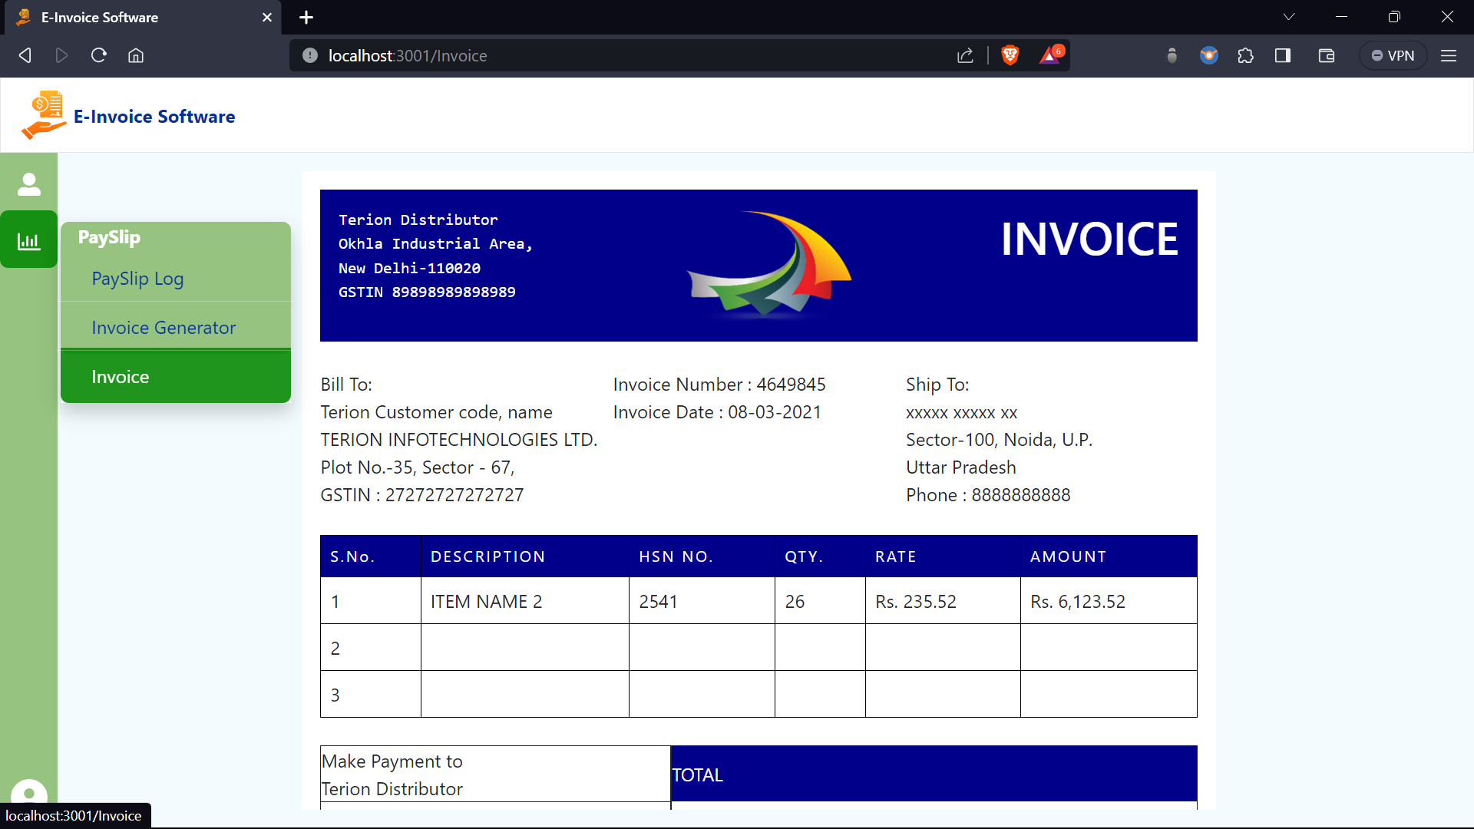
E-Invoice Software

Slide 17
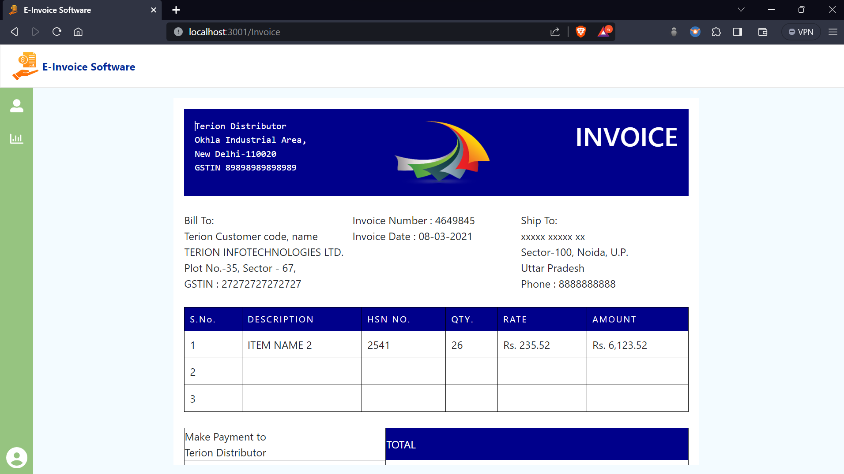
E-Invoice Software

Slide 18
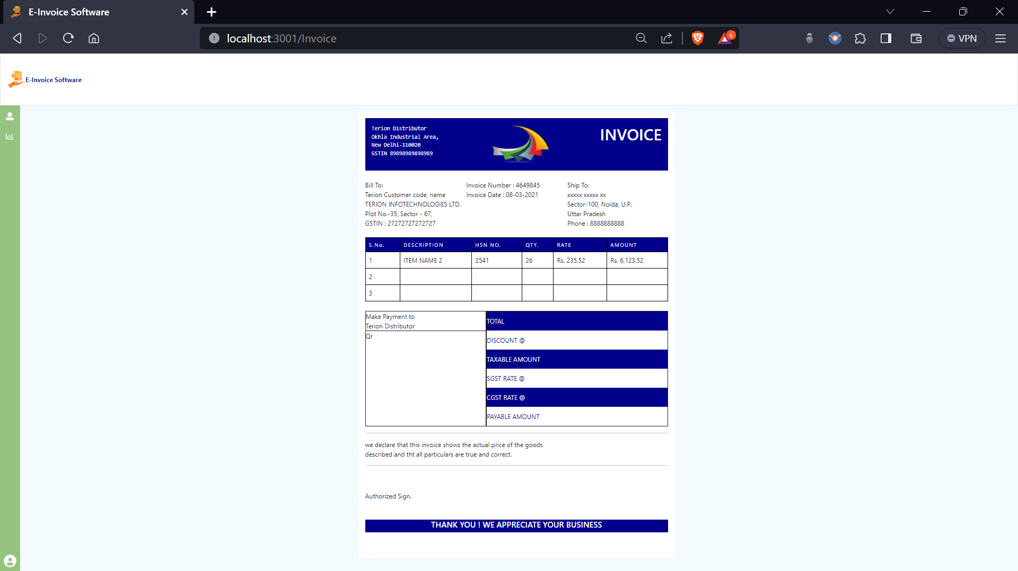
E-Invoice Software

Slide 19
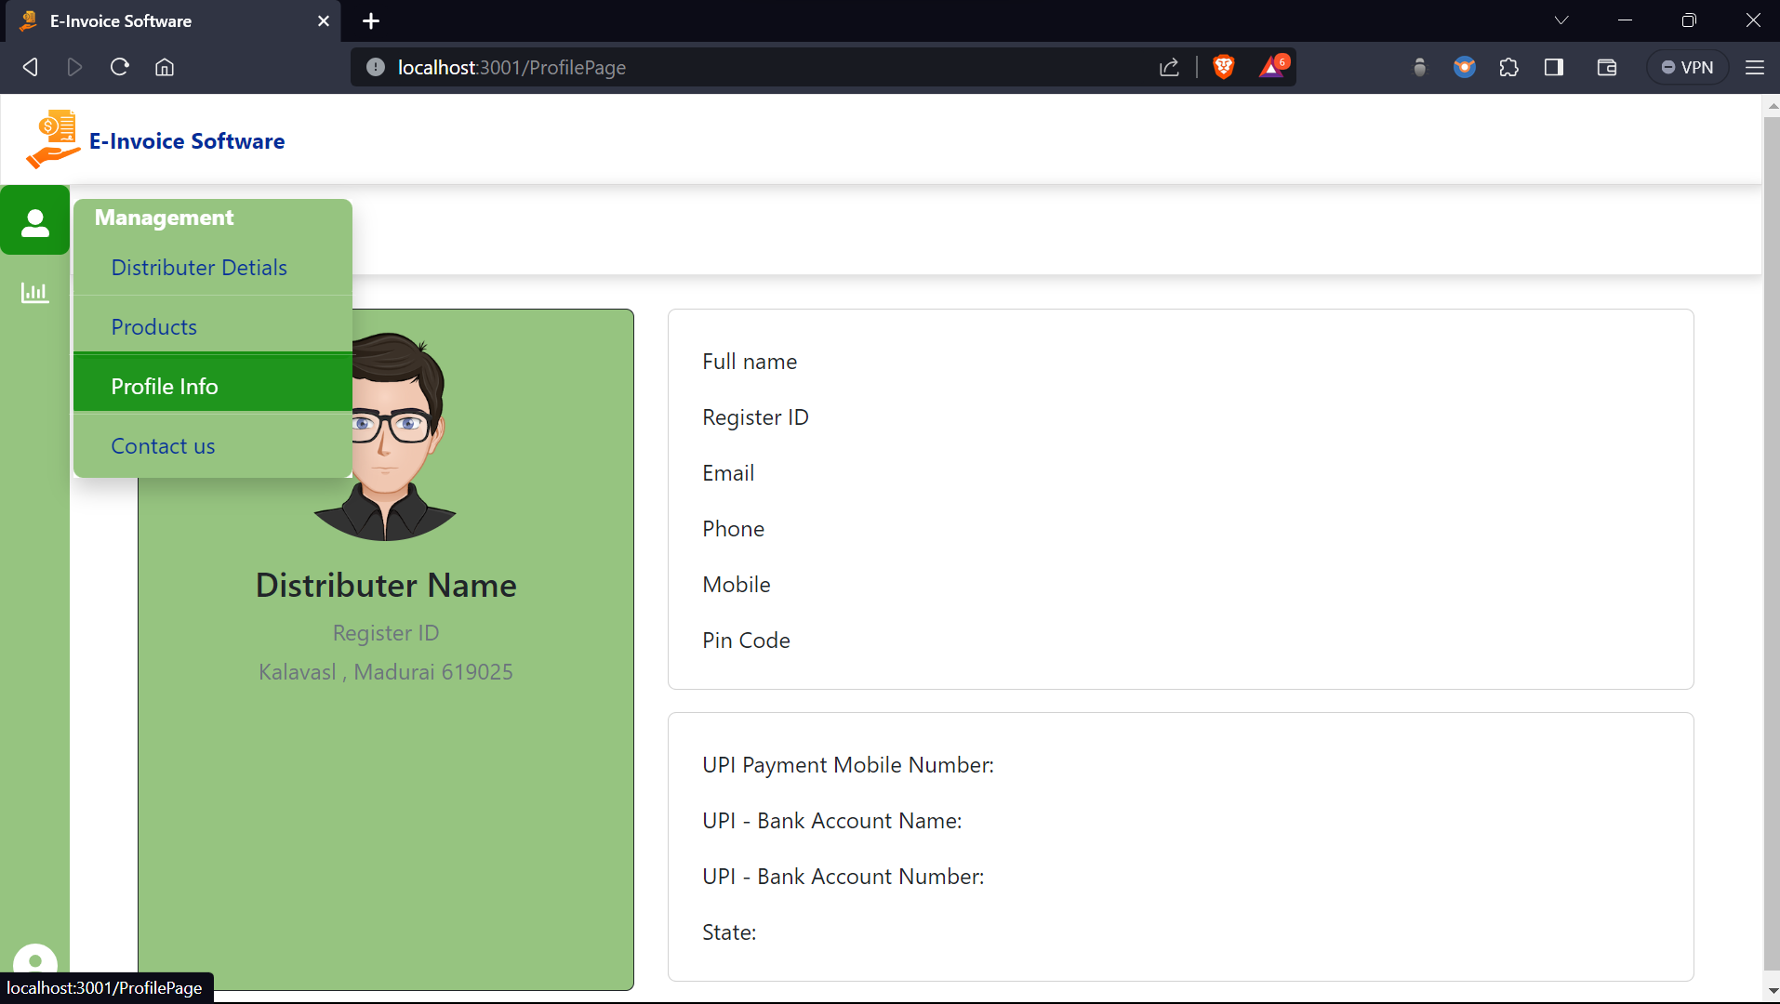
E-Invoice Software

Slide 20
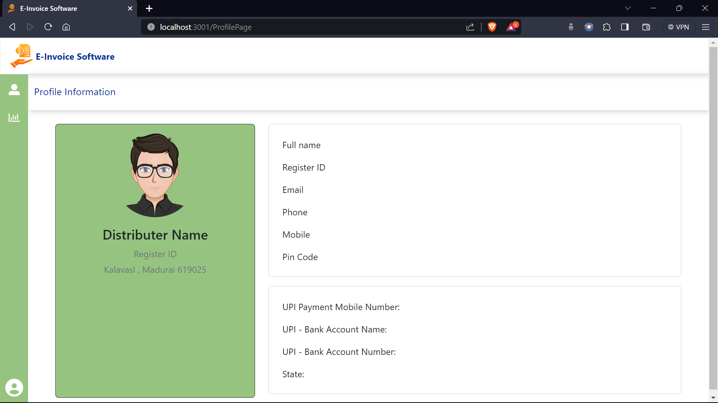
E-Invoice Software

Slide 21
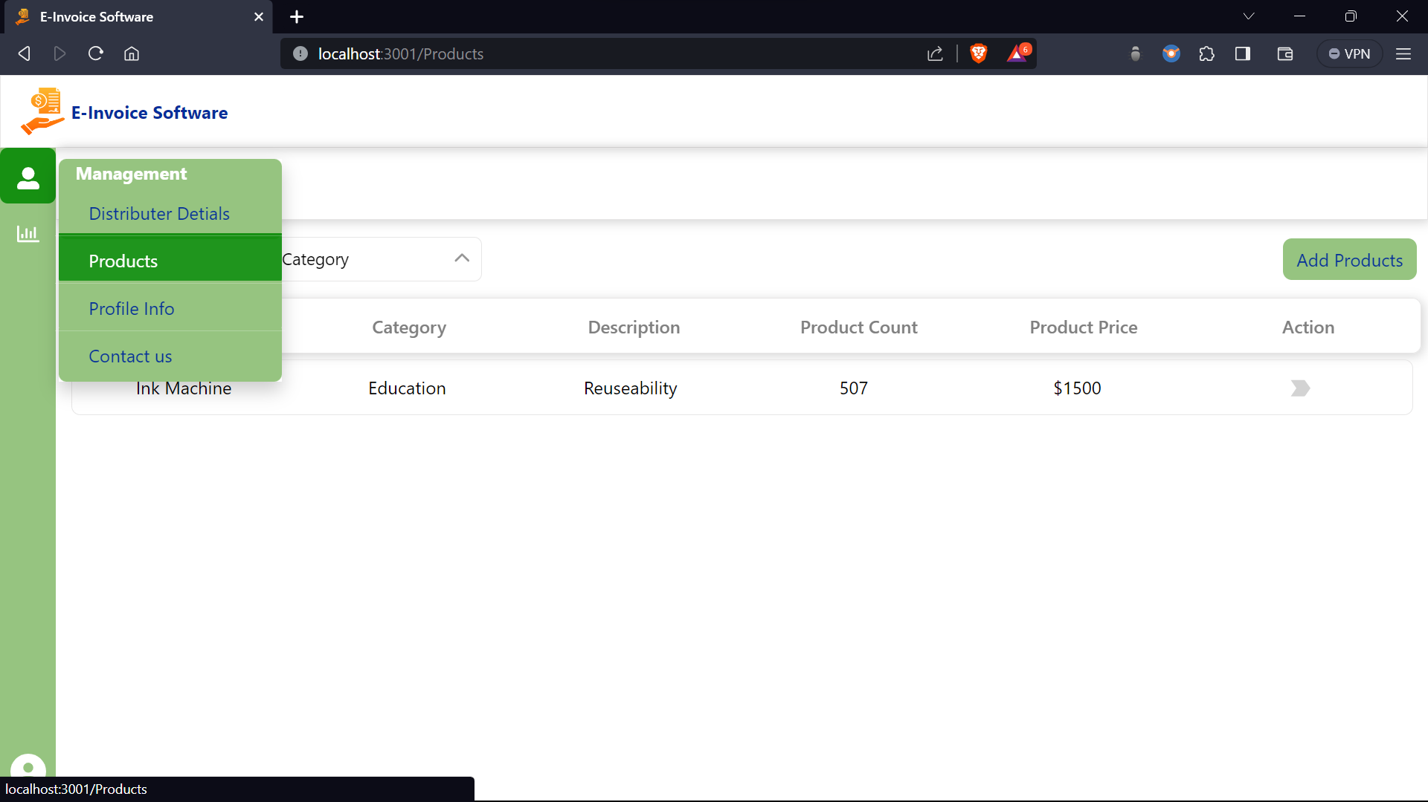
E-Invoice Software

Slide 22
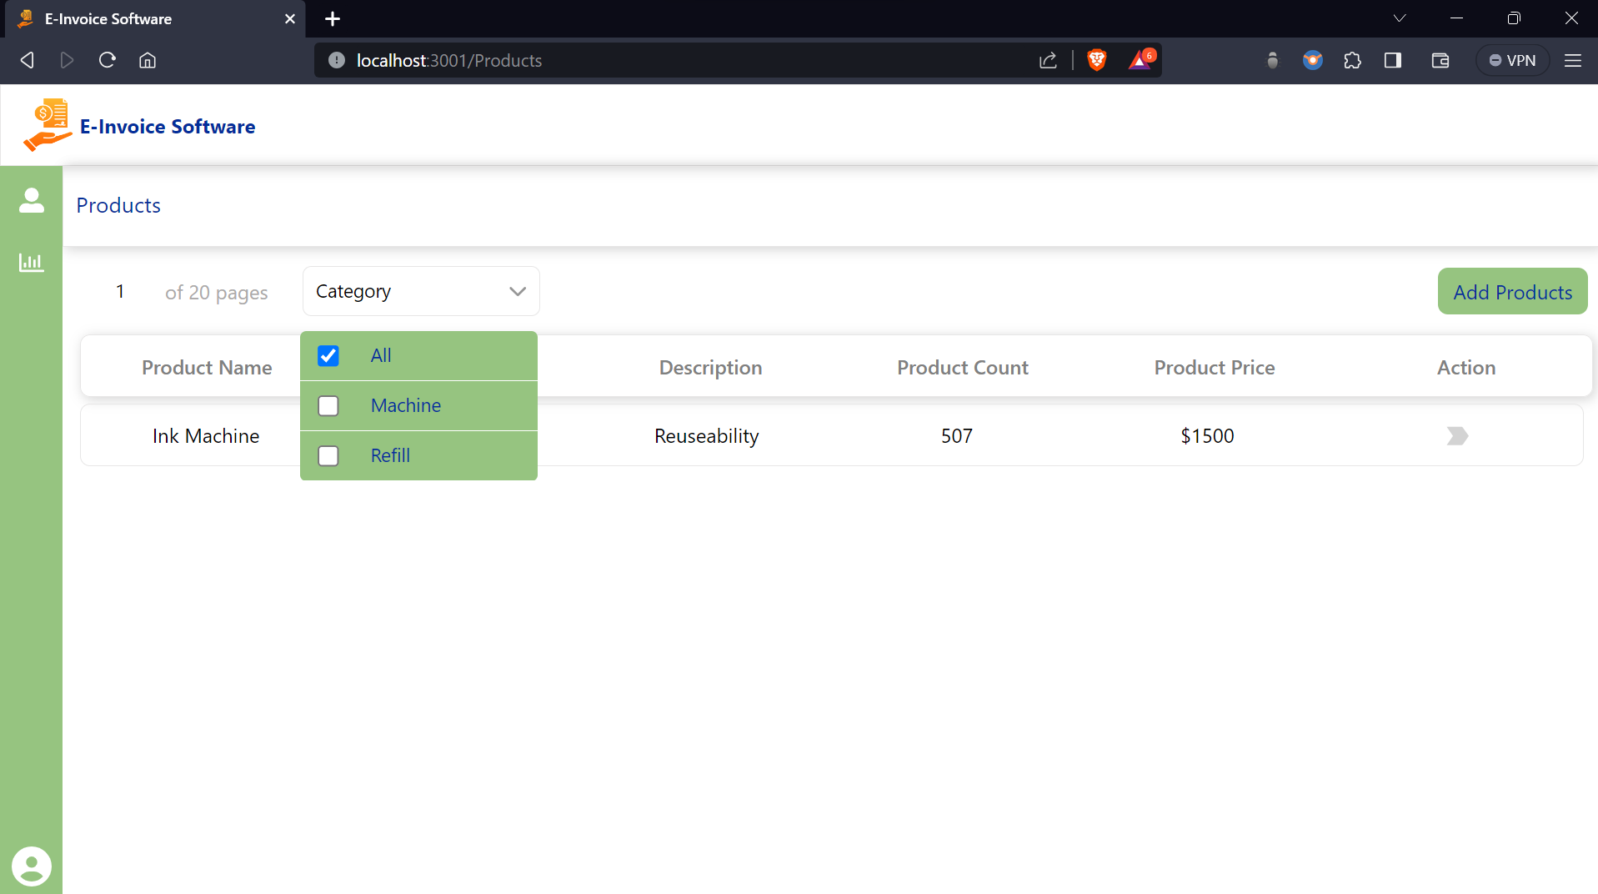
E-Invoice Software

Slide 23
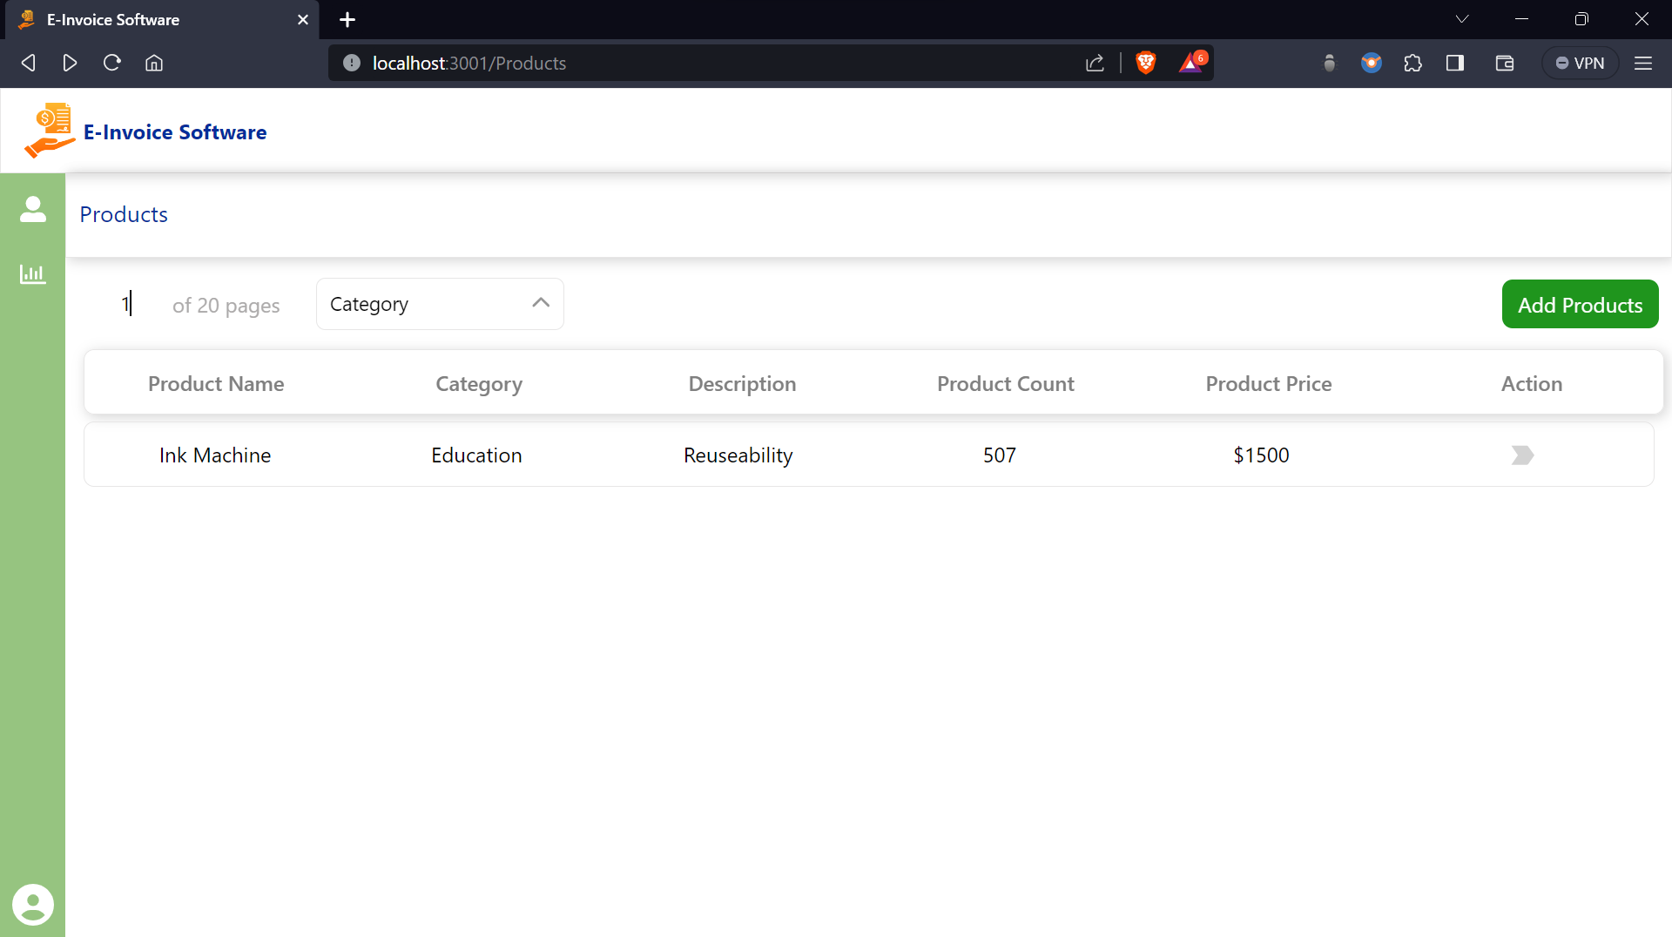
E-Invoice Software

Slide 24

E-Invoice Software

Slide 25
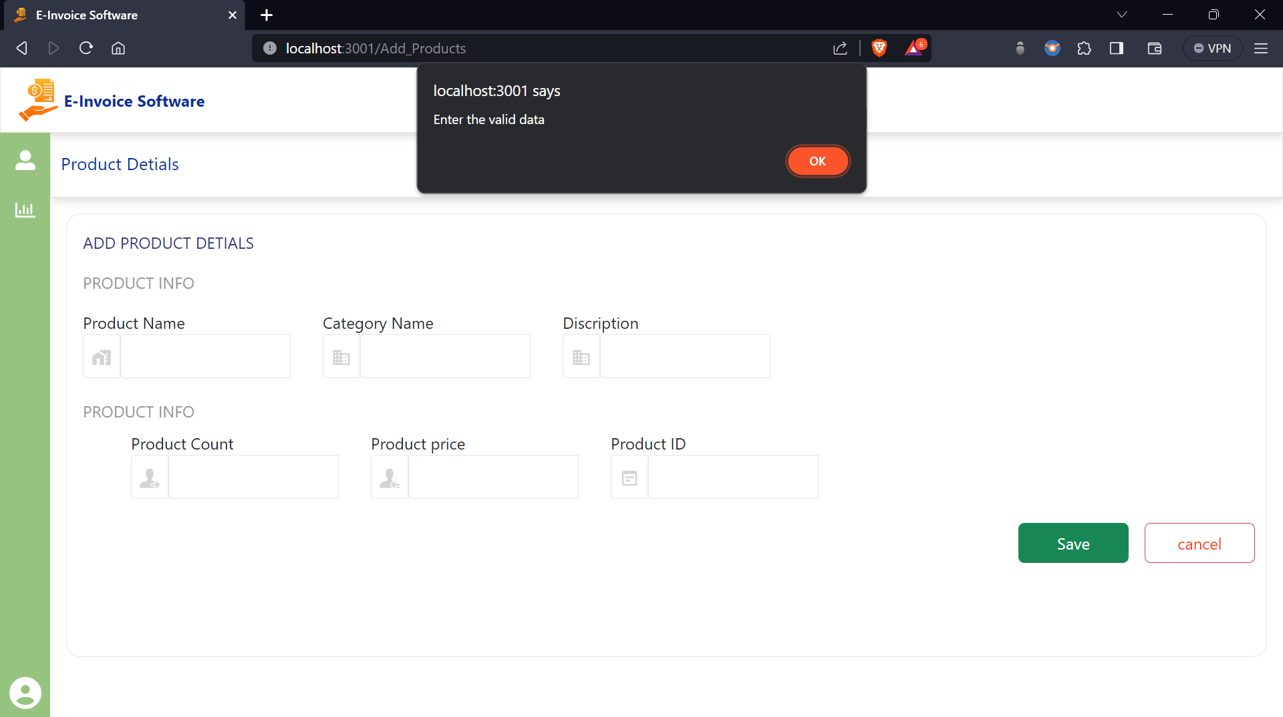
E-Invoice Software

Slide 26

E-Invoice Software

Slide 27
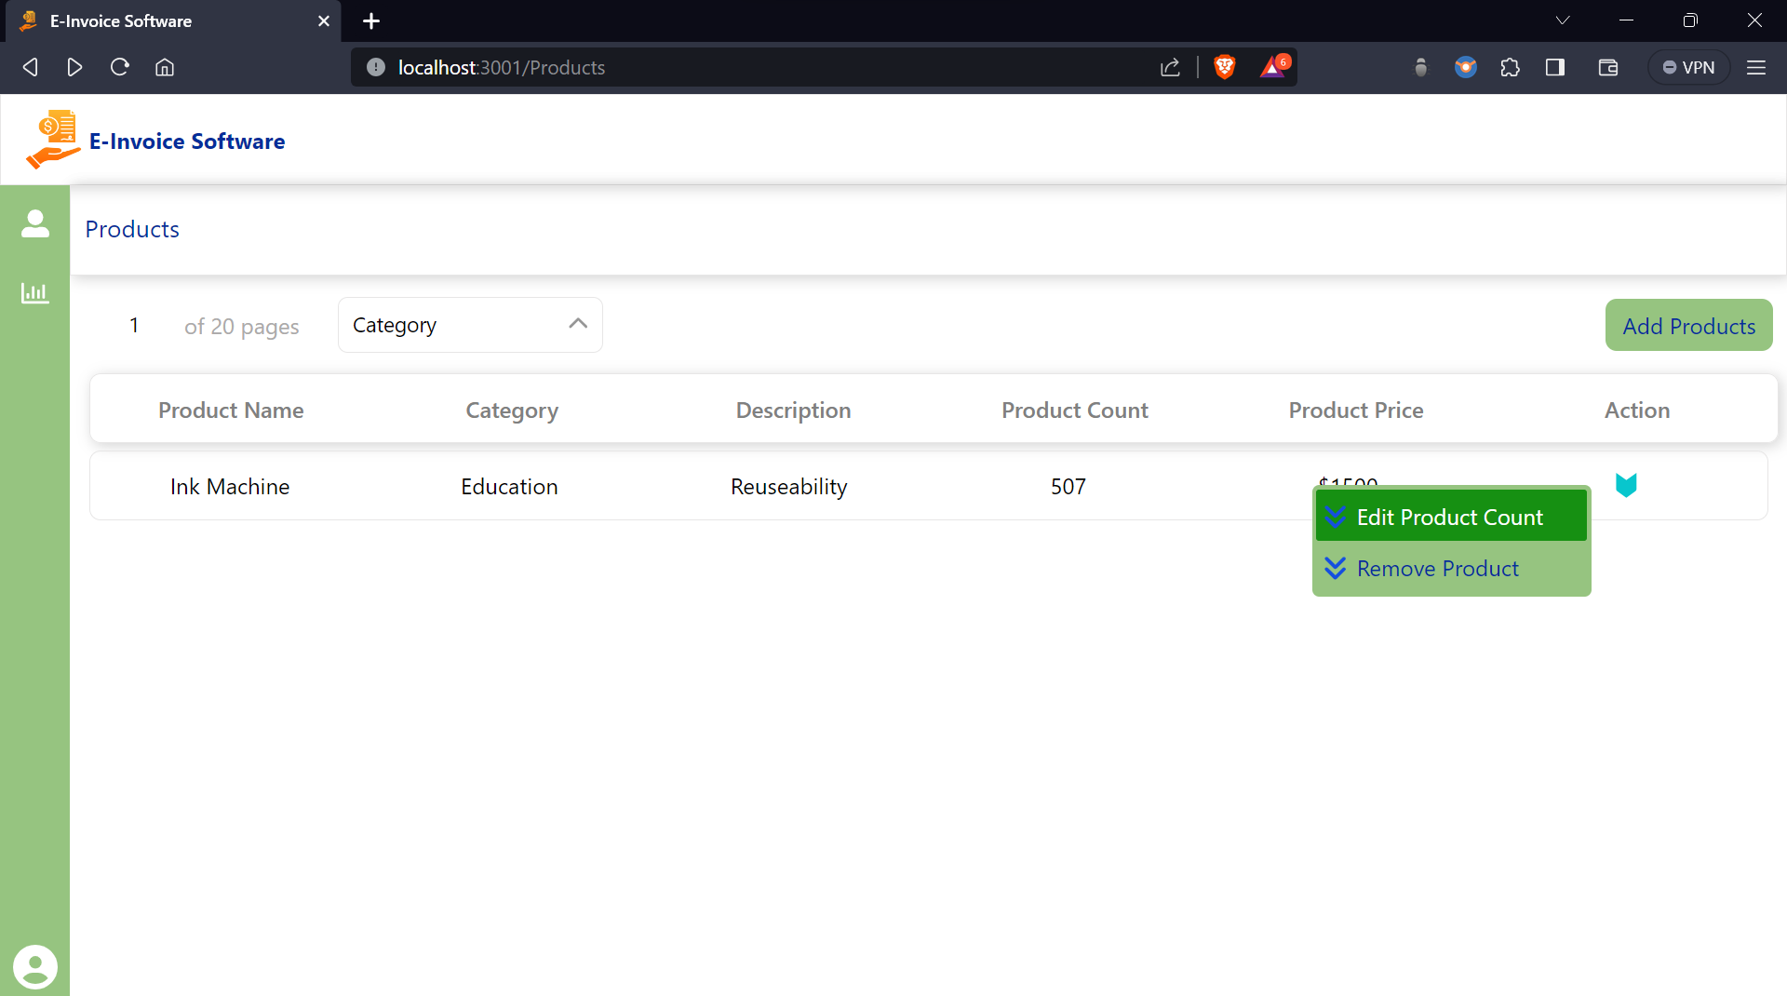
E-Invoice Software

Slide 28
E-Invoice Software
THANK YOU
@ Copyrights Quantantics Techserv PVT LTD

